Slide 1

Tokenization and Embedding in Large Language Models: Techniques and Applications
Understanding key concepts in natural language processing
Notes:
AI-generated content may be incorrect. --- This presentation focuses on the crucial concepts of tokenization and embedding within large language models (LLMs). We'll explore their definitions, techniques, applications, and the significant role they play in natural language processing.

Slide 2

Presentation Topics
Introduction to Large Language Models (LLMs)
Understanding Tokenization
Embedding Techniques
Integration of Tokenization and Embedding in LLMs
Applications and Implications
Notes:
In this presentation, we will cover the introduction to large language models, dive into the details of tokenization, explore various embedding techniques, and discuss the integration of these components in LLMs. Finally, we will examine their practical applications and future implications in the field of NLP.

Slide 3
Introduction to Large Language Models (LLMs)
Notes:
Large language models are advanced deep learning architectures designed to understand and generate human-like text. They have transformed the field of NLP by enabling sophisticated language processing capabilities.

Slide 4
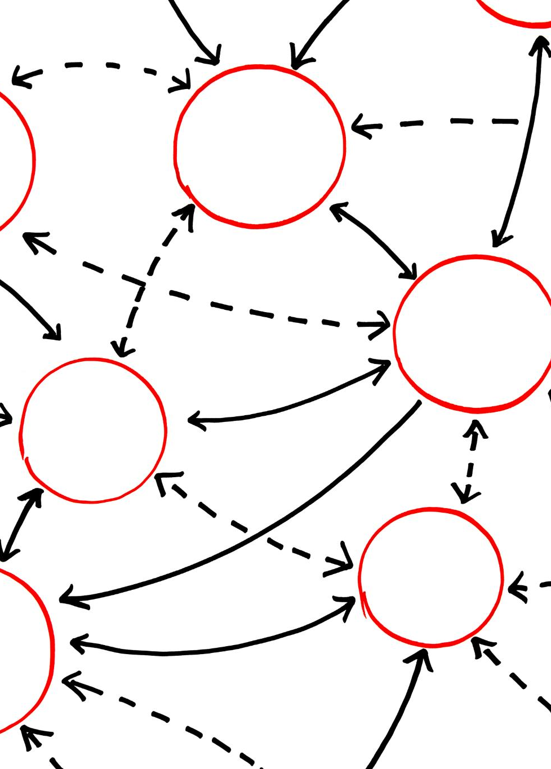
Definition and Significance of LLMs
Understanding LLMs
Large language models are trained on vast text datasets to comprehend language and perform various tasks effectively.
Contextual Understanding
LLMs excel at understanding context, enabling them to generate relevant and coherent text based on input.
Industry Applications
The applications of LLMs span various industries, enhancing tasks such as customer support, content creation, and data analysis.
Notes:
Large language models are defined as models trained on vast amounts of text data to perform a variety of language tasks. They are significant due to their ability to understand context, generate coherent text, and their application in various industries.

Slide 5
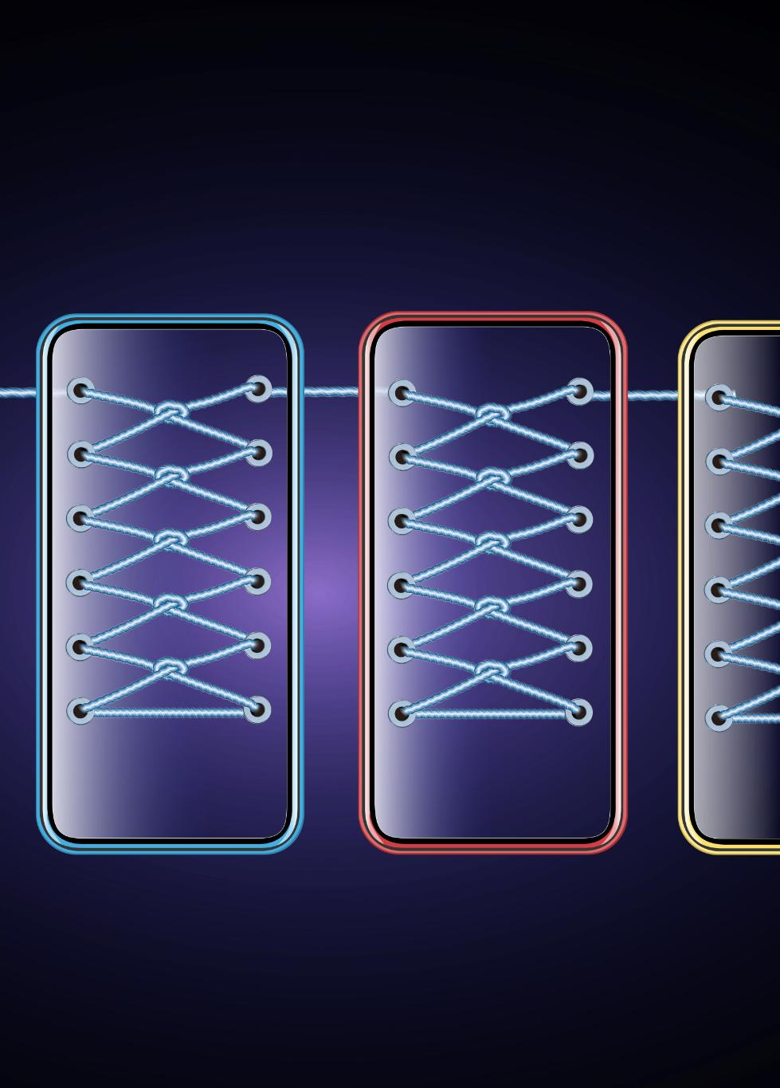
Key Components and Architecture
Transformers in LLMs
Transformers serve as the backbone of LLMs, enabling efficient text processing by utilizing self-attention to weigh the importance of different words.
Attention Mechanisms
Attention mechanisms allow LLMs to focus on relevant parts of the input text, enhancing understanding and contextual awareness during text generation.
Multi-layer Networks
Multi-layer networks enable LLMs to learn complex language patterns by stacking layers of neurons, enhancing representation learning.
Notes:
The architecture of LLMs typically includes components such as transformers, attention mechanisms, and multi-layer networks. These allow LLMs to process and generate text efficiently by capturing complex language patterns.

Slide 6

Popular LLM Examples (GPT, BERT, Etc.)
Generative Language Models
Generative language models are designed to produce human-like text, making them ideal for creative writing and content generation.
Understanding Context
Some models excel at understanding context in text, making them suitable for tasks like sentiment analysis and language translation.
Task-Specific Models
Each model can be fine-tuned for specific natural language processing tasks, enhancing performance in those areas.
Notes:
Popular examples of large language models include GPT (Generative Pre-trained Transformer) and BERT (Bidirectional Encoder Representations from Transformers). Each model has unique strengths and is tailored for different NLP tasks.

Slide 7
Understanding Tokenization
Notes:
Tokenization is the process of converting a text input into smaller units called tokens. This foundational step is crucial for text processing in NLP applications.

Slide 8

What Is Tokenization?
Definition of Tokenization
Tokenization is the process of breaking text into smaller, manageable pieces for analysis and understanding.
Purpose of Tokenization
Tokenization helps language models comprehend and analyze written content effectively, improving natural language processing tasks.
Notes:
Tokenization involves breaking down text into meaningful elements, such as words, phrases, or symbols. It helps LLMs understand and analyze text effectively.

Slide 9
Types of Tokenization (Word, Subword, Character, Etc.)
Word Tokenization
Word tokenization is the process of splitting text into individual words. It is commonly used in many natural language processing tasks.
Subword Tokenization
Subword tokenization involves breaking down words into smaller units or subwords, improving efficiency in handling rare words.
Character Tokenization
Character tokenization splits text into individual characters. It is useful for languages with complex word formations and for certain machine learning models.
Notes:
There are various types of tokenization methods, including word tokenization, subword tokenization (like Byte Pair Encoding), and character tokenization. Each method has its advantages and use cases.

Slide 10

Challenges in Tokenization
Out-of-Vocabulary Words
One of the main challenges in tokenization is accurately processing out-of-vocabulary words that are not in the training data.
Handling Different Languages
Tokenization must adapt to various languages, each with distinct syntax and grammar rules, making it complex.
Managing Context
Understanding context is crucial for effective tokenization, as it impacts the meaning and usage of words.
Notes:
Tokenization poses challenges such as dealing with out-of-vocabulary words, handling different languages, and managing context. Addressing these challenges is essential for effective text representation.

Slide 11
Embedding Techniques
Notes:
Embedding techniques are crucial for converting tokens into numerical representations that LLMs can process. These techniques capture semantic meaning and relationships between words.

Slide 12

Concept of Word Embeddings
Dense Vector Representations
Word embeddings are dense vector representations of words, which help in capturing their meanings based on context.
Understanding Relationships
Word embeddings enable language models to comprehend relationships and similarities between words effectively.
Notes:
Word embeddings are dense vector representations of words that capture their meanings based on context. They allow LLMs to understand relationships and similarities between words.

Slide 13

Common Embedding Methods (Word2Vec, GloVe, FastText)
Word2Vec Overview
Word2Vec is an embedding method that uses neural networks to learn word associations from large datasets, making it effective for various NLP tasks.
GloVe Features
GloVe (Global Vectors for Word Representation) captures global word co-occurrences, providing rich contextual word representations suitable for semantic analysis.
FastText Advantages
FastText extends Word2Vec by considering subword information, making it particularly useful for morphologically rich languages and out-of-vocabulary words.
Notes:
Popular embedding methods include Word2Vec, GloVe (Global Vectors for Word Representation), and FastText. Each method has unique features that make them suitable for various NLP applications.

Slide 14
Contextual Embeddings in LLMs
Dynamic Word Representations
Contextual embeddings provide dynamic word representations that change based on surrounding text, enhancing language understanding.
Models like BERT
BERT is a prominent model that utilizes contextual embeddings to improve language processing tasks through better context understanding.
Understanding Language Nuances
By considering context, these embeddings help models grasp subtle nuances and meanings in human language.
Notes:
Contextual embeddings, used in models like BERT, take the context of words into account, providing dynamic representations that change based on the surrounding words, improving understanding of nuances in language.

Slide 15
Integration of Tokenization and Embedding in LLMs
Notes:
The integration of tokenization and embedding is vital for LLMs to convert text data into formats suitable for processing, enabling effective learning and understanding.

Slide 16
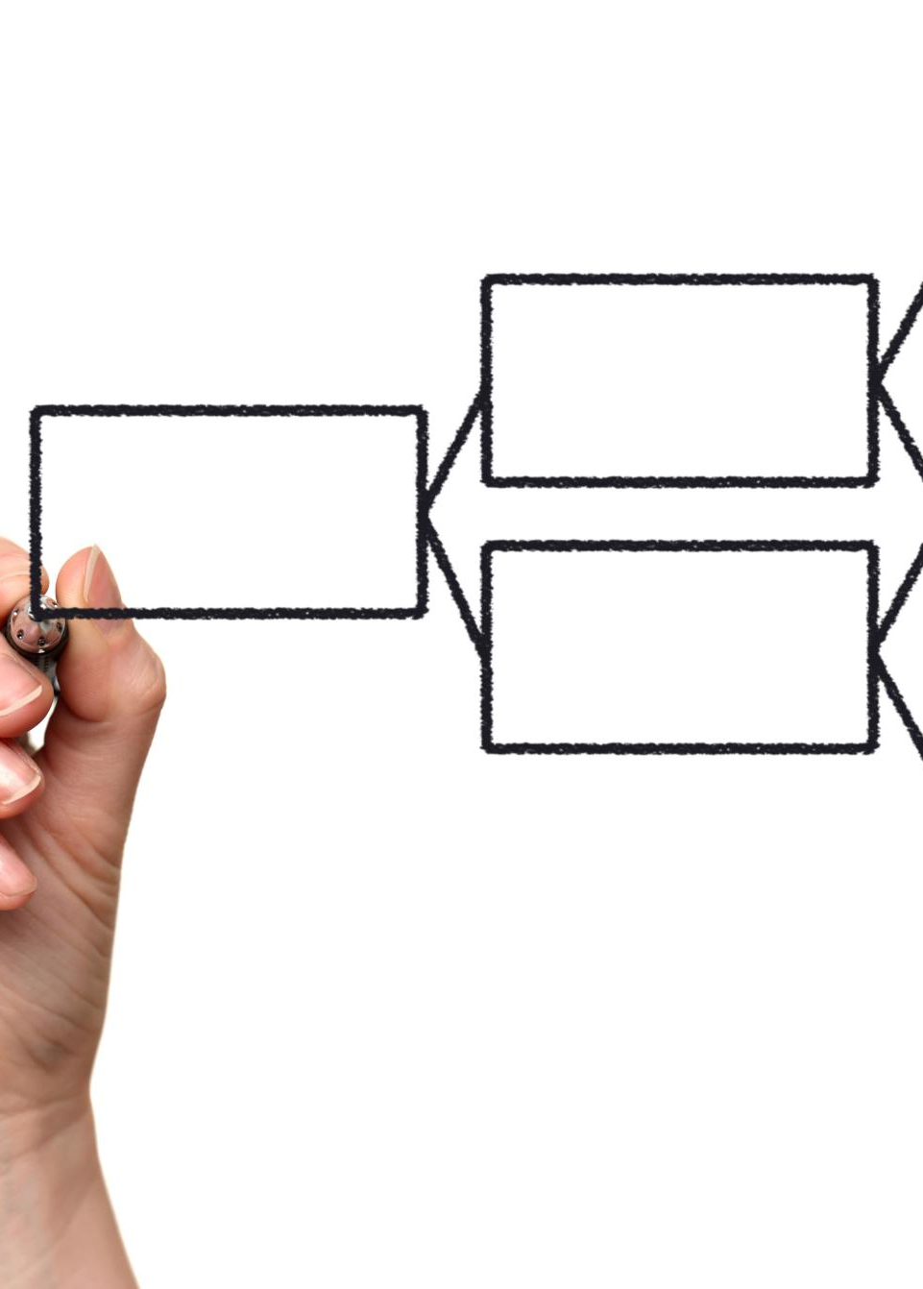
Process From Text to Embeddings
Tokenization Process
Tokenization is the first step, breaking down text into individual units or tokens for further analysis.
Generating Embeddings
After tokenization, embeddings are generated, representing words or phrases in a numerical format that algorithms can process.
Importance for LLMs
This pipeline is essential for large language models (LLMs) to analyze and generate human-like text effectively.
Notes:
The process of transforming text to embeddings involves tokenization followed by embedding generation. This pipeline is critical for LLMs to analyze and generate language.

Slide 17

Role of Tokenization in Embedding Generation
Importance of Tokenization
Tokenization is essential for breaking down text into manageable units, facilitating better understanding by models.
Impact on Embeddings
Effective tokenization leads to more meaningful embeddings, which directly improve model accuracy and performance.
Notes:
Tokenization plays a key role in embedding generation by defining the units of text that will be represented. Effective tokenization ensures meaningful embeddings that enhance model performance.

Slide 18

Optimization Techniques
Fine-Tuning
Fine-tuning is an important optimization technique that adjusts pre-trained models to improve their performance on specific tasks.
Regularization
Regularization techniques help prevent overfitting by adding constraints to the model, thus improving its generalization capabilities.
Tokenization
Tokenization is a crucial step in preprocessing text data, transforming raw text into manageable pieces for better analysis.
Embedding Process
The embedding process converts tokens into vector representations, enhancing the model's ability to understand and generate language.
Notes:
Optimization techniques, such as fine-tuning and regularization, are employed to improve the performance of LLMs during the tokenization and embedding process, resulting in better language understanding.

Slide 19
Applications and Implications
Notes:
Tokenization and embedding techniques have far-reaching applications in areas such as translation, sentiment analysis, and question answering, impacting how we process and understand language.

Slide 20

Practical Applications of Tokenization and Embedding
Machine Translation
Tokenization and embedding techniques play a crucial role in improving the accuracy and fluency of machine translation systems.
Chatbots
These techniques enhance chatbot functionality, enabling more natural interactions and improved understanding of user queries.
Recommendation Systems
Tokenization and embedding are essential in developing recommendation systems that personalize user experiences effectively.
Notes:
These techniques are utilized in various practical applications, including machine translation, chatbots, and recommendation systems, showcasing their importance in enhancing user experiences.

Slide 21

Impact on NLP Tasks (Translation, Sentiment Analysis, Etc.)
Importance of Tokenization
Tokenization is essential for breaking down text into meaningful components, enhancing the accuracy of NLP models.
Role of Embedding
Embedding techniques allow for representing words in a continuous vector space, improving the performance of NLP tasks.
Advancing NLP Applications
Improvements in tokenization and embedding have led to advancements in various NLP applications, including translation and sentiment analysis.
Notes:
Tokenization and embedding significantly influence NLP tasks by improving accuracy and efficiency in translation, sentiment analysis, and more, thus advancing the field.

Slide 22
Future Developments and Challenges
Advancements in Technology
Future developments in tokenization and embedding in NLP promise greater efficiency and accuracy in language processing tasks.
Language Diversity Challenges
Managing language diversity presents significant challenges for models, requiring innovative approaches to ensure inclusivity.
Ensuring Model Fairness
Ensuring fairness in NLP models is crucial to prevent bias and promote equitable outcomes across different languages and contexts.
Notes:
The future of tokenization and embedding in NLP holds promise with advancements in technology and methodology. However, challenges such as managing language diversity and ensuring model fairness remain.

Slide 23
Conclusion
Role of Tokenization
Tokenization is crucial for breaking down text into manageable pieces, facilitating better processing by language models.
Importance of Embedding
Embedding transforms words into numerical representations, enabling machines to understand context and relationships in language.
Future of NLP
The evolving techniques of tokenization and embedding continue to shape the advancement of natural language processing applications.
Notes:
In conclusion, tokenization and embedding are vital components of large language models, enabling them to process and understand human language. Their techniques and applications continue to evolve, shaping the future of NLP.

